Slide 1
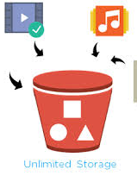
S3 – simple Storage services
logesh​

Slide 2
Agenda
1
2
3
4
5
What is s3
Types of S3 Storage Classes
S3 Security
S3 Properties
Cross region Replication

Slide 3
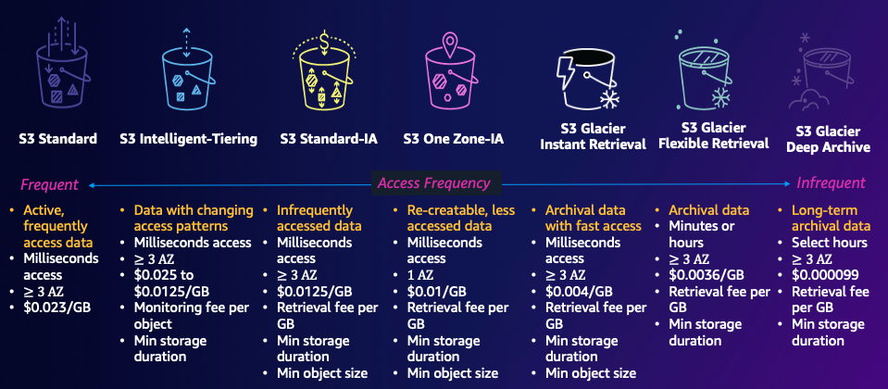
logesh​

Slide 4
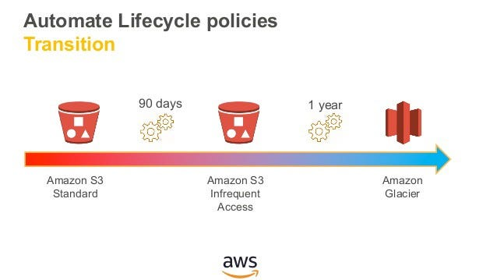
logesh​

Slide 5
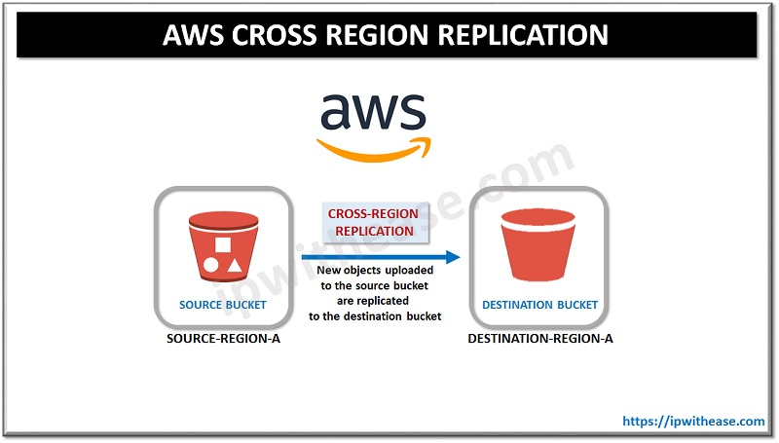
logesh​
logesh

Slide 6
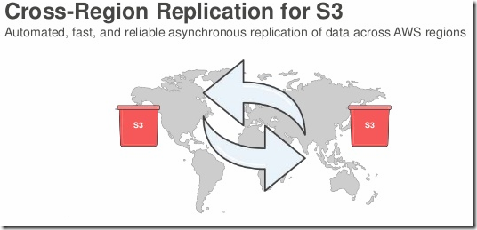
logesh​
logesh

